Slide 1

359
212 $+$ 147 $=$
Hundreds | Tens | Ones
 | H | T | O
 | 2 | 1 | 2
 | 1 | 4 | 7
+
+
3
5
9
3
5
9
ones
tens
Do we have enough _______ to make an exchange?
hundreds

Slide 2





Have a think
564
351 $+$ 213 $=$
Hundreds | Tens | Ones
 | H | T | O
 | 3 | 5 | 1
 | 2 | 1 | 3
+
+
5
6
4
5
6
4
ones
tens
hundreds
Do we have enough _______ to make an exchange?

Slide 3
168 + 29 =
197
$+$ 20
$+$ 2
$+$ 7
168
188
190
197
$+$ 2
$+$ 7
$+$ 20
168
170
177
197

Slide 4
168 + 42 =
210
$+$ 2
$+$ 30
$+$ 10
168
170
200
210

Slide 5

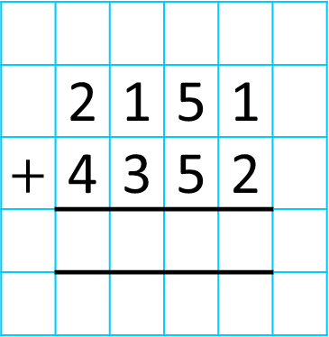
Th | H | T | O
 | 2 | 1 | 5 | 1
$+$ | 4 | 3 | 5 | 2
6
5
0
3
1
6
5
0
3
5
I have ___ tens, so I ___ need
to make an exchange.
do
I have ___ hundreds, so I ______ need
to make an exchange.
do not
I have ___ thousands, so I ______ need
to make an exchange.
10
I have ___ ones, so I ______ need
to make an exchange.
6
3
do not
do not

Slide 6
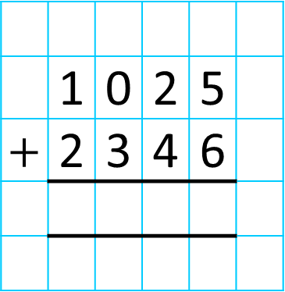
Th | H | T | O
 | 1 | 0 | 2 | 5
$+$ | 2 | 3 | 4 | 6
3
3
7
1
1
3
3
7
1

Slide 7


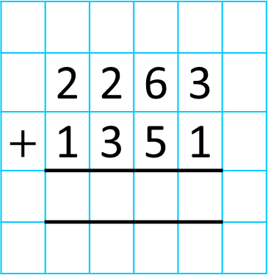
Teddy runs 1,351 metres.
Whitney runs 2,263 metres.
How many metres do they run altogether?
3,614
Th | H | T | O
 | 2 | 2 | 6 | 3
$+$ | 1 | 3 | 5 | 1
3
6
1
4
1
3
6
1
4

