Slide 1


Slide 3


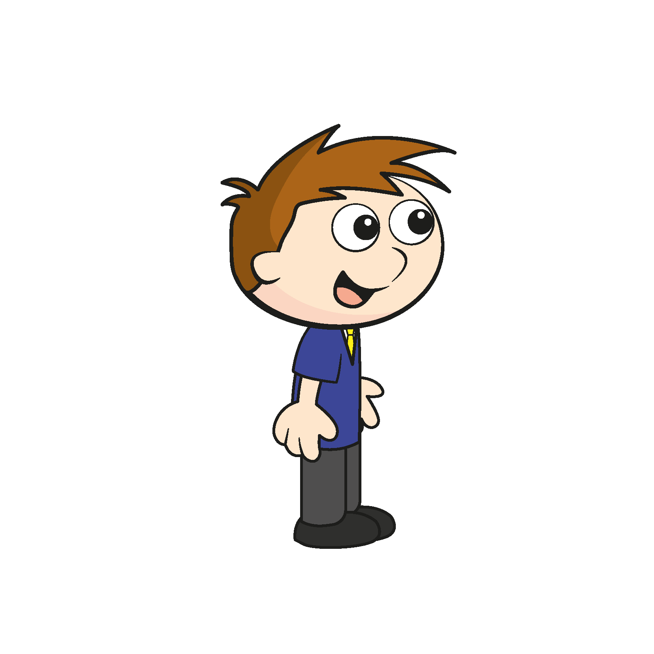
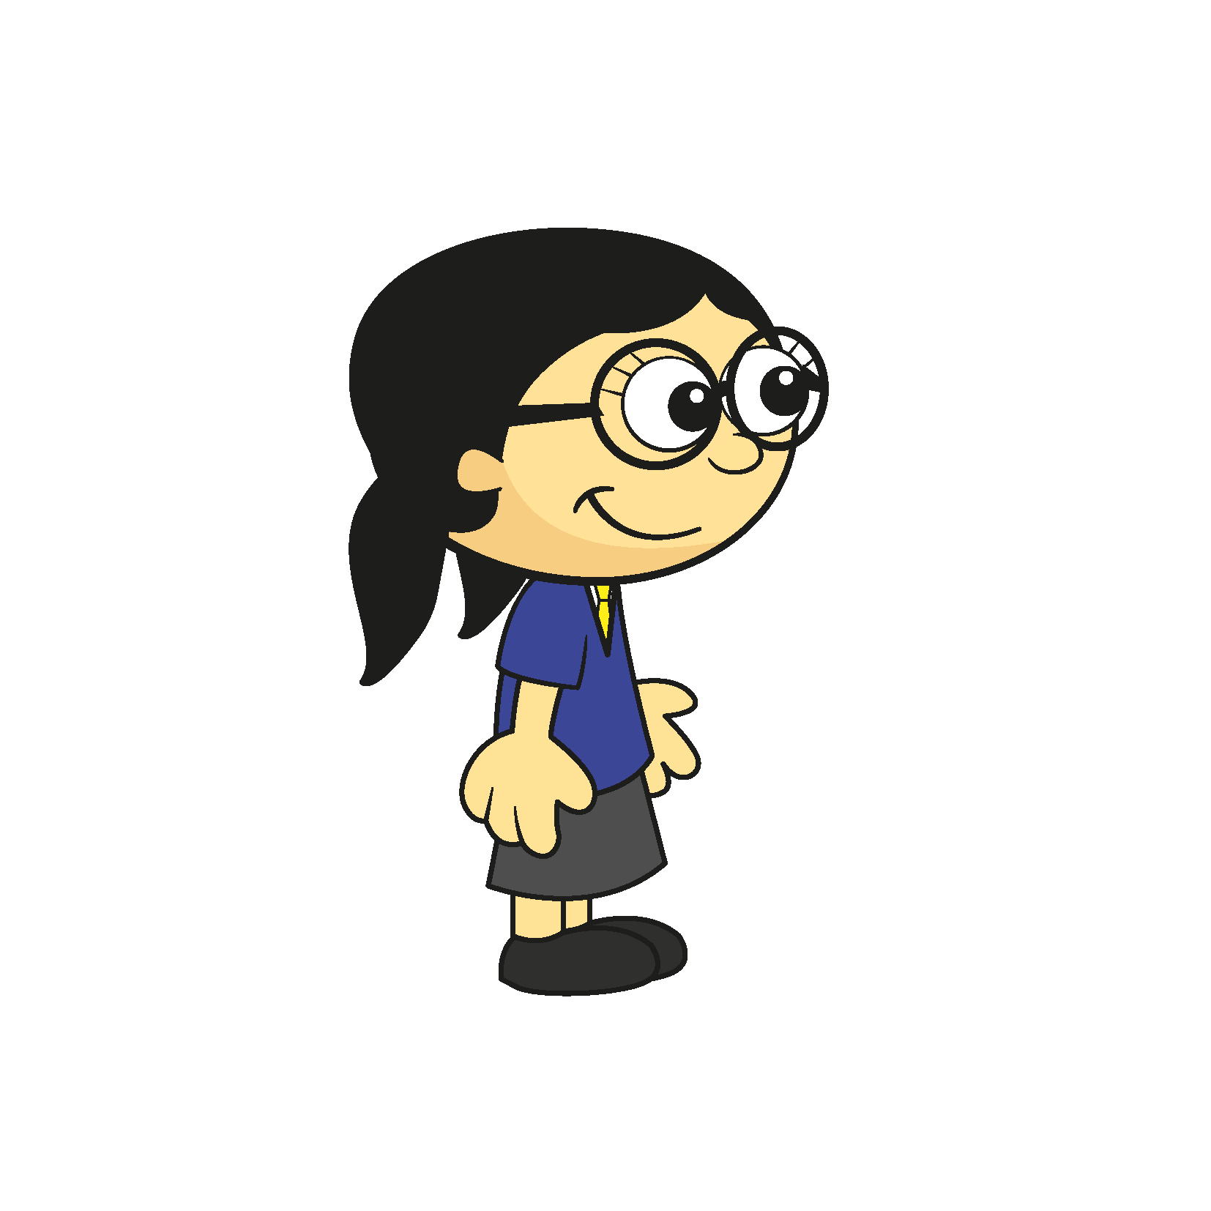
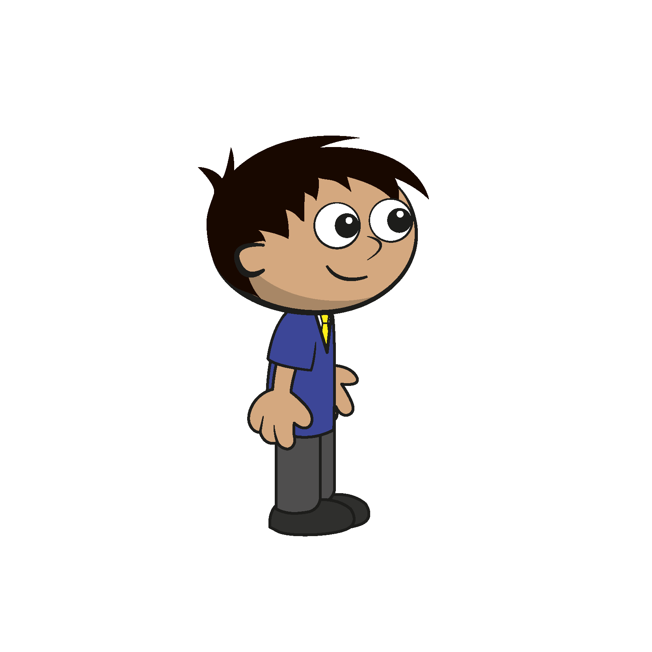
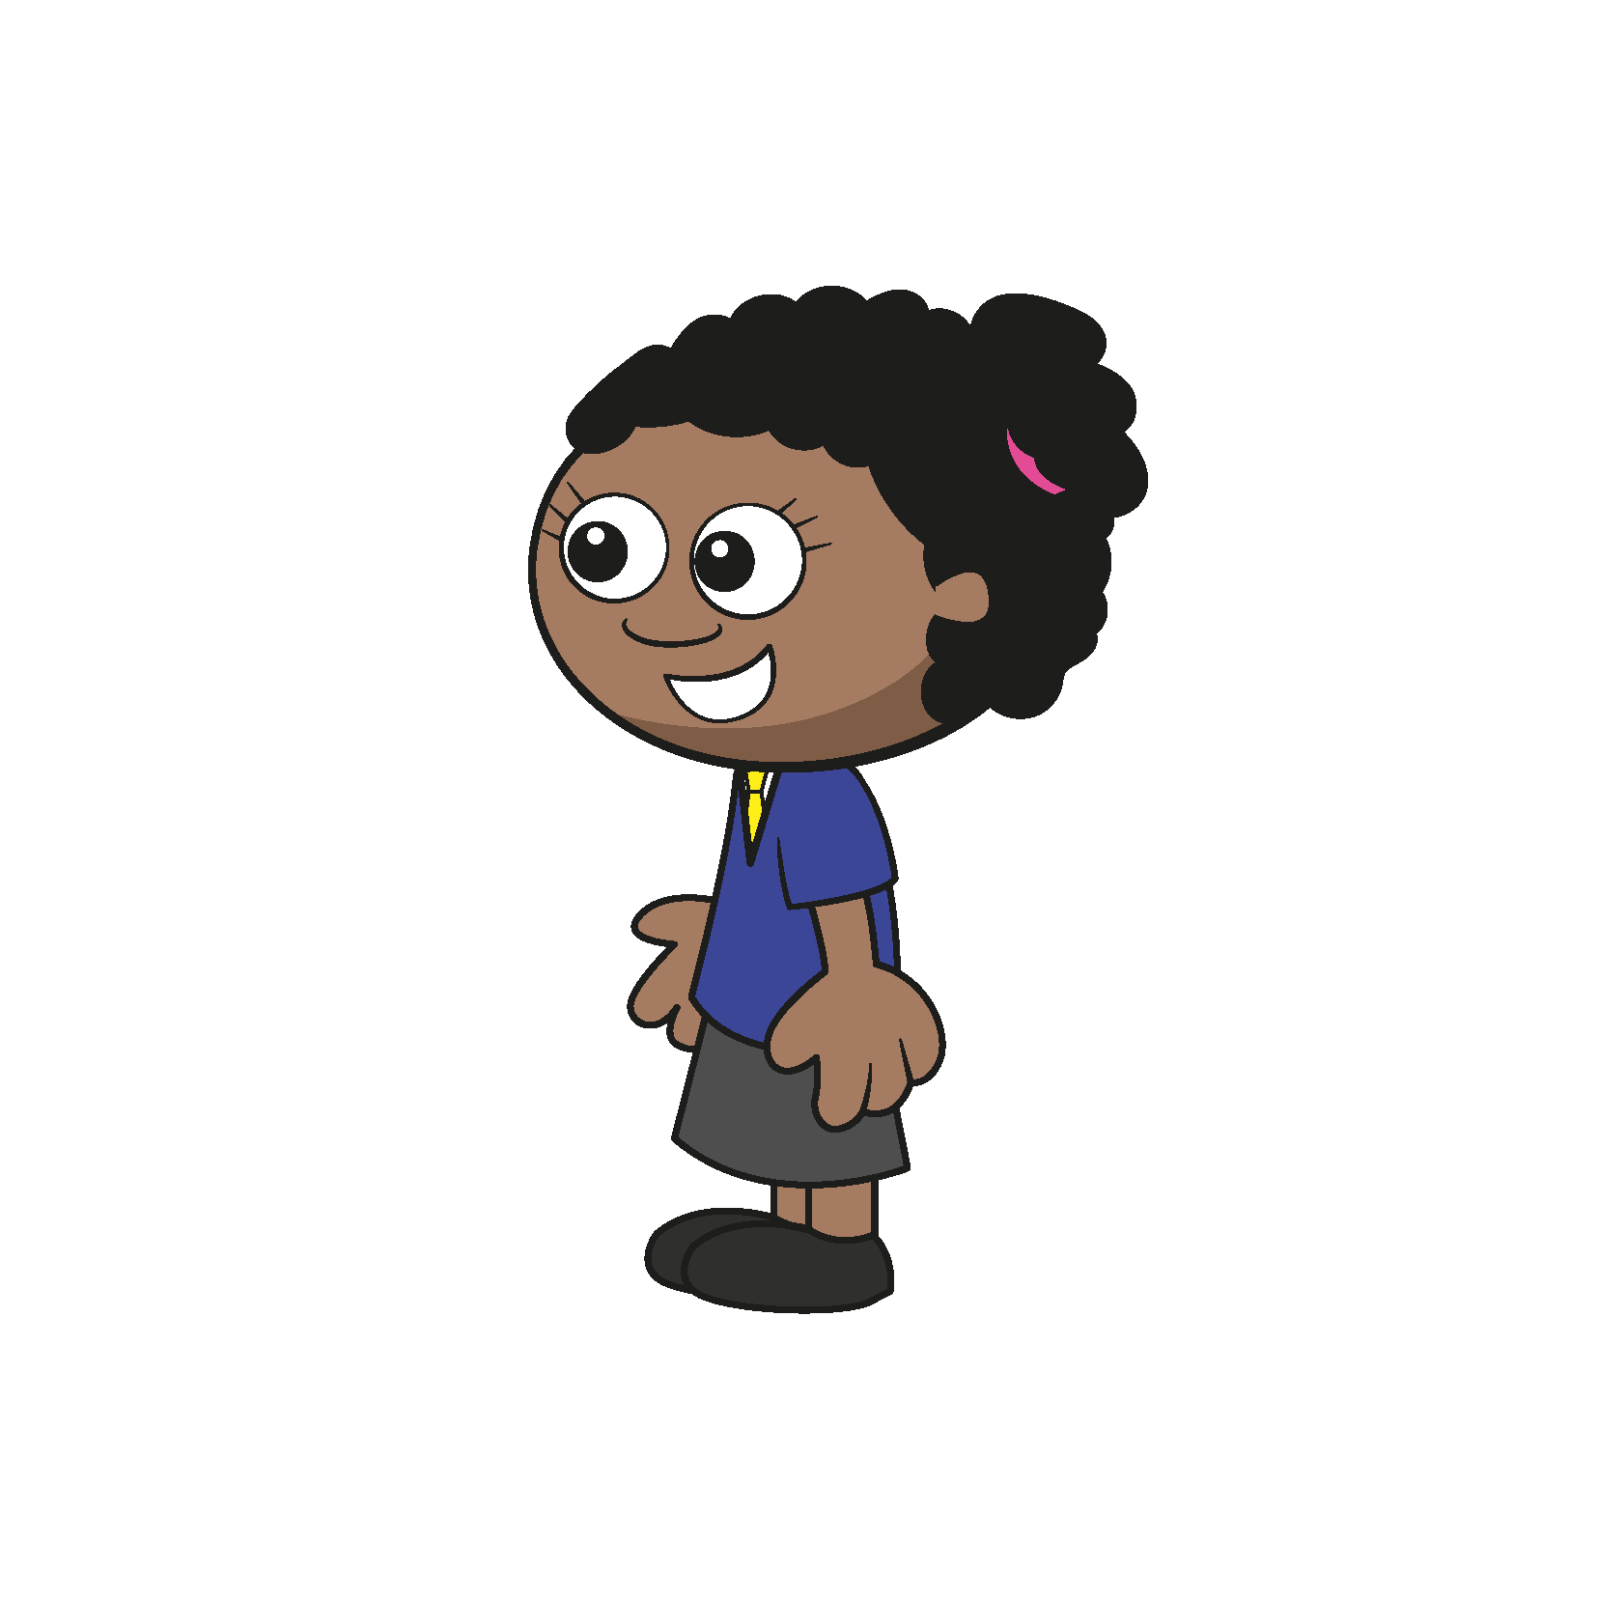
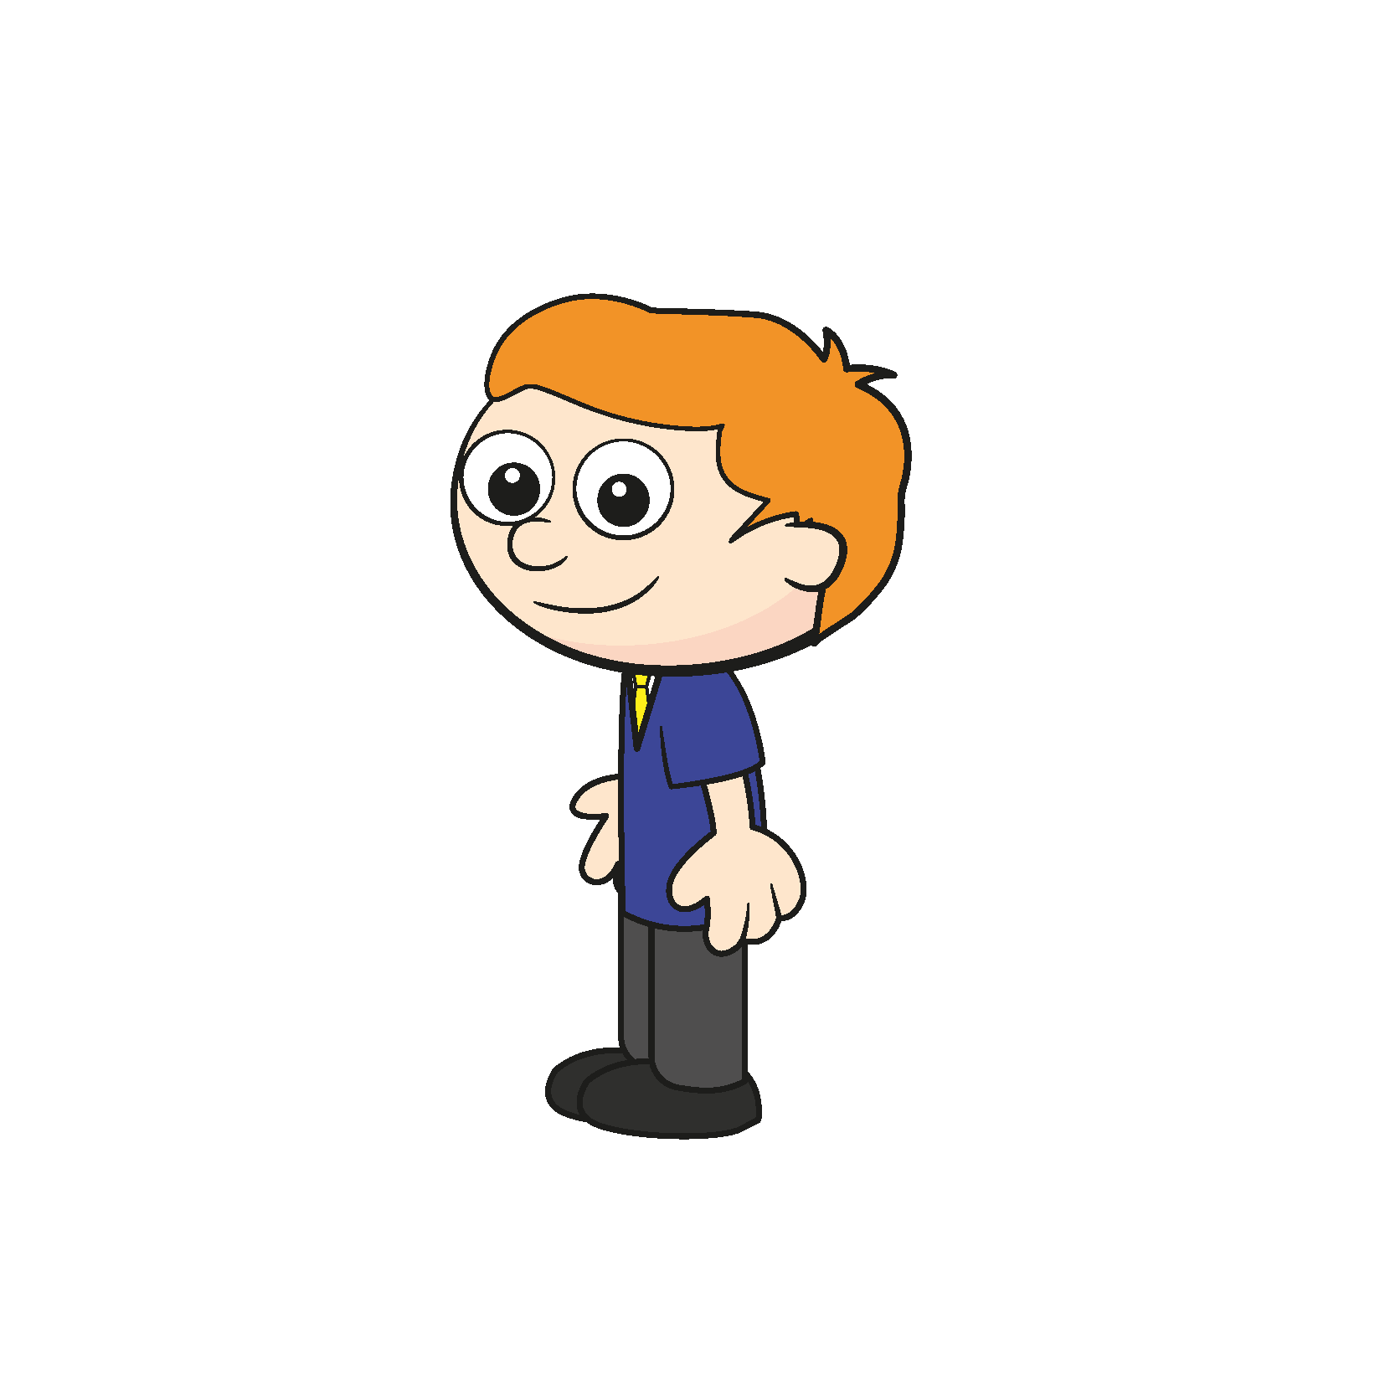
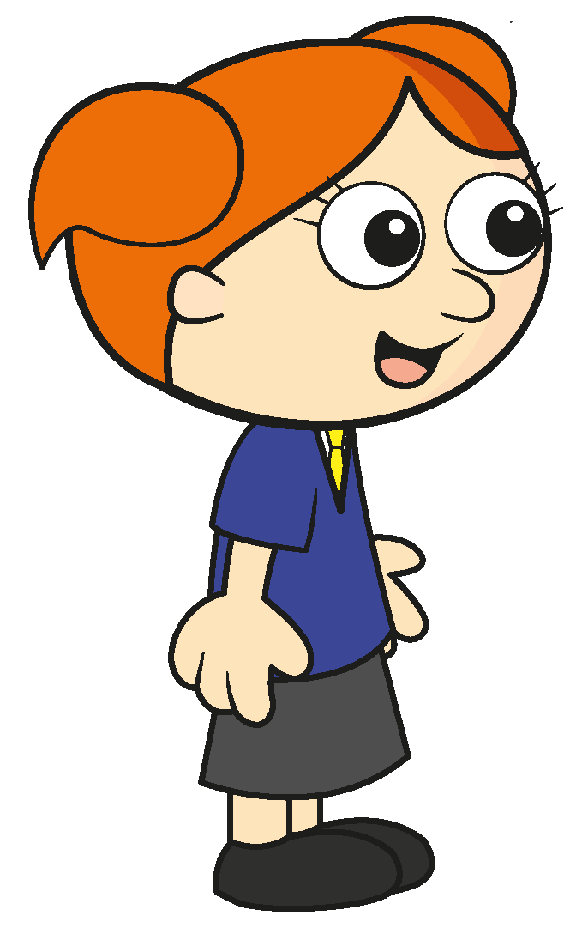
1) How many counters are there in total?
2) How many cubes are there?
3) How many children are wearing glasses?
4) How many are not wearing glasses?

Slide 4
1) How many counters are there in total?
2) How many cubes are there?
3) How many children are wearing glasses?
4) How many are not wearing glasses?
8
3
1
5

Slide 6
is a part.
is a part.
The whole is
3
1
4

Slide 7
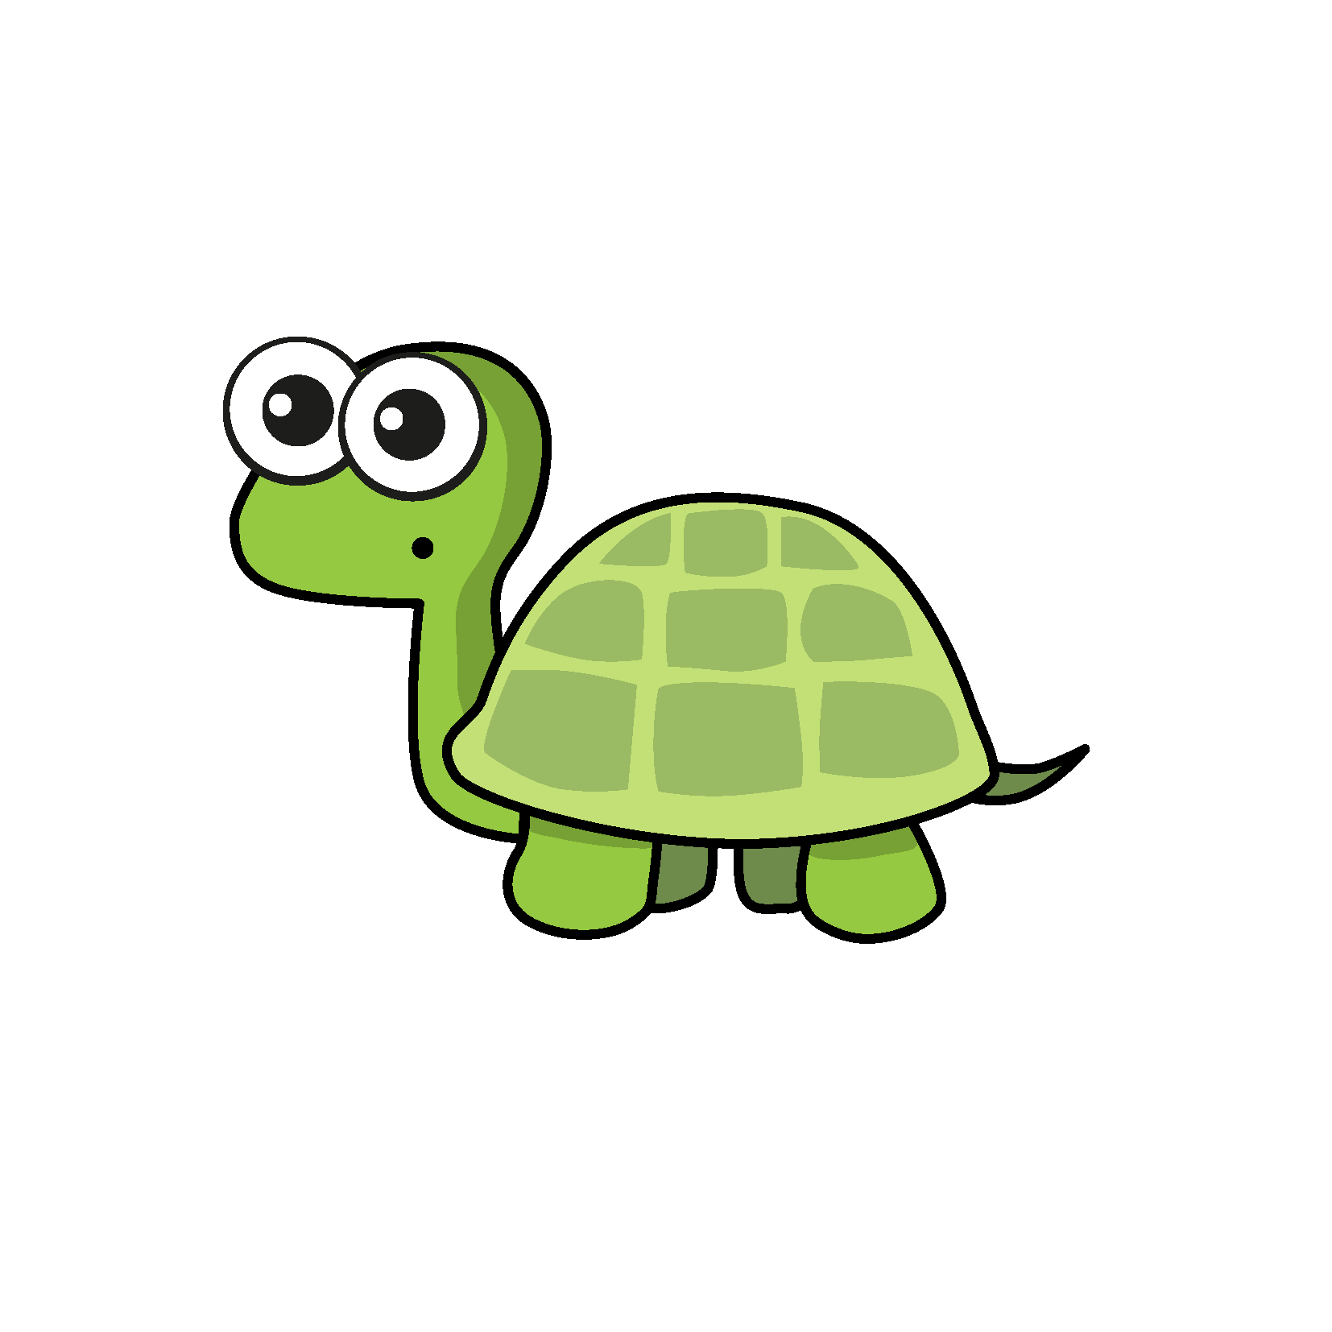

So it does not matter which way round the parts are.
is a part.
is a part.
The whole is
2
They are the wrong way round.
3
5
Have a think

Slide 8


Collect 8 double-sided counters.
Shake and drop them.
is a part.
is a part.
The whole is
5
3
8

Slide 9
Collect 8 double-sided counters.
Shake and drop them.
is a part.
is a part.
The whole is

Slide 10
Tiny records some results.
 | Part | Part | Whole
5 3 8
2 6 8
4 4 8
The whole is always greater than a part.
Is this always true?
8 0 8
Have a think

Slide 11
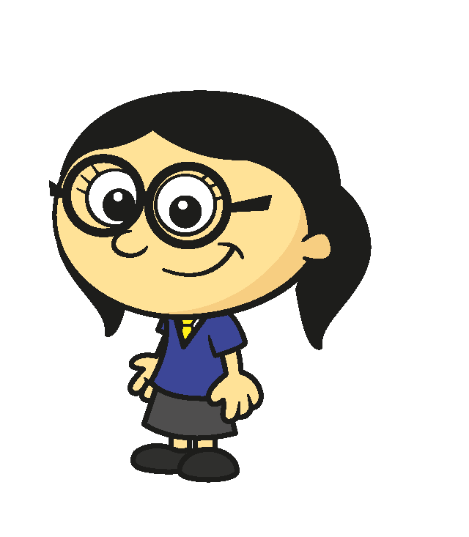


Collect five bean bags.
Try to throw the bean bags in a hoop.
is a part.
is a part.
The whole is
2
Can zero ever be a part?
3
5

Slide 12
Collect five bean bags.
Try to throw the bean bags in a hoop.
is a part.
is a part.
The whole is
Can zero ever be a part?

Slide 13
Have a go at questions

Slide 14
I do
You do

Slide 15









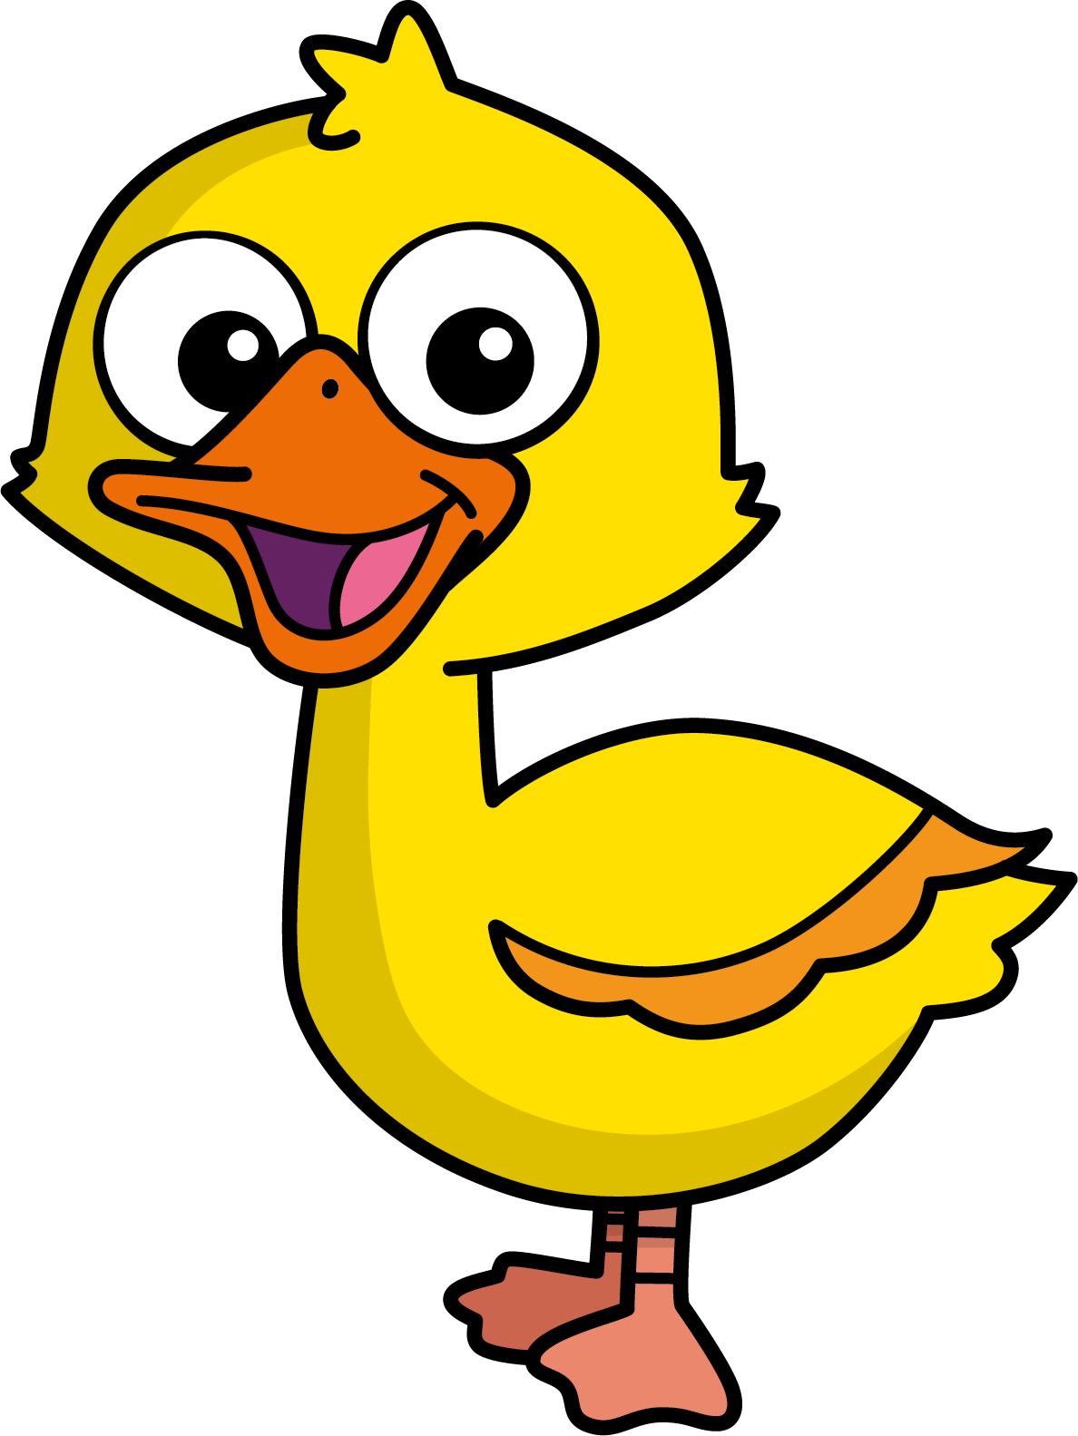
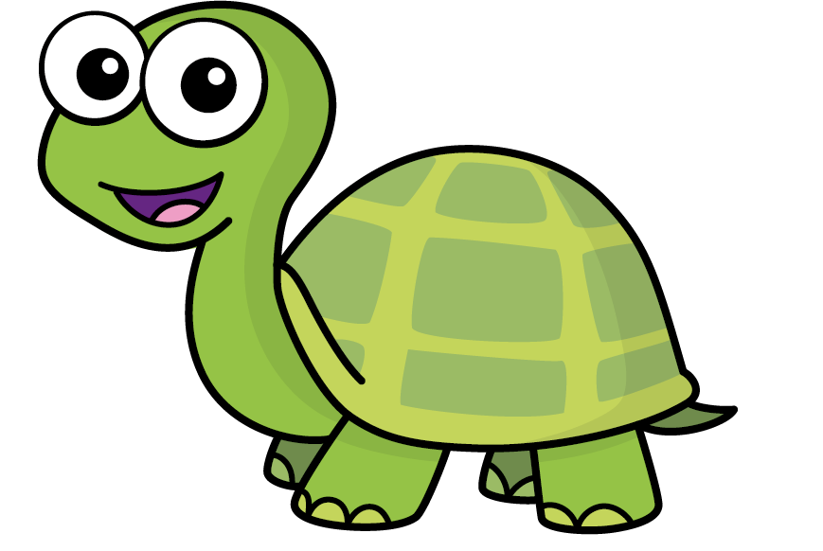
Mo
Jack
Eva
Ron
Max
Kim
Jo
Sam
Speech bubble text
Bee
Diddy
Tiny

Slide 16








T | O
H | T | O
100
40 | 60

Slide 17





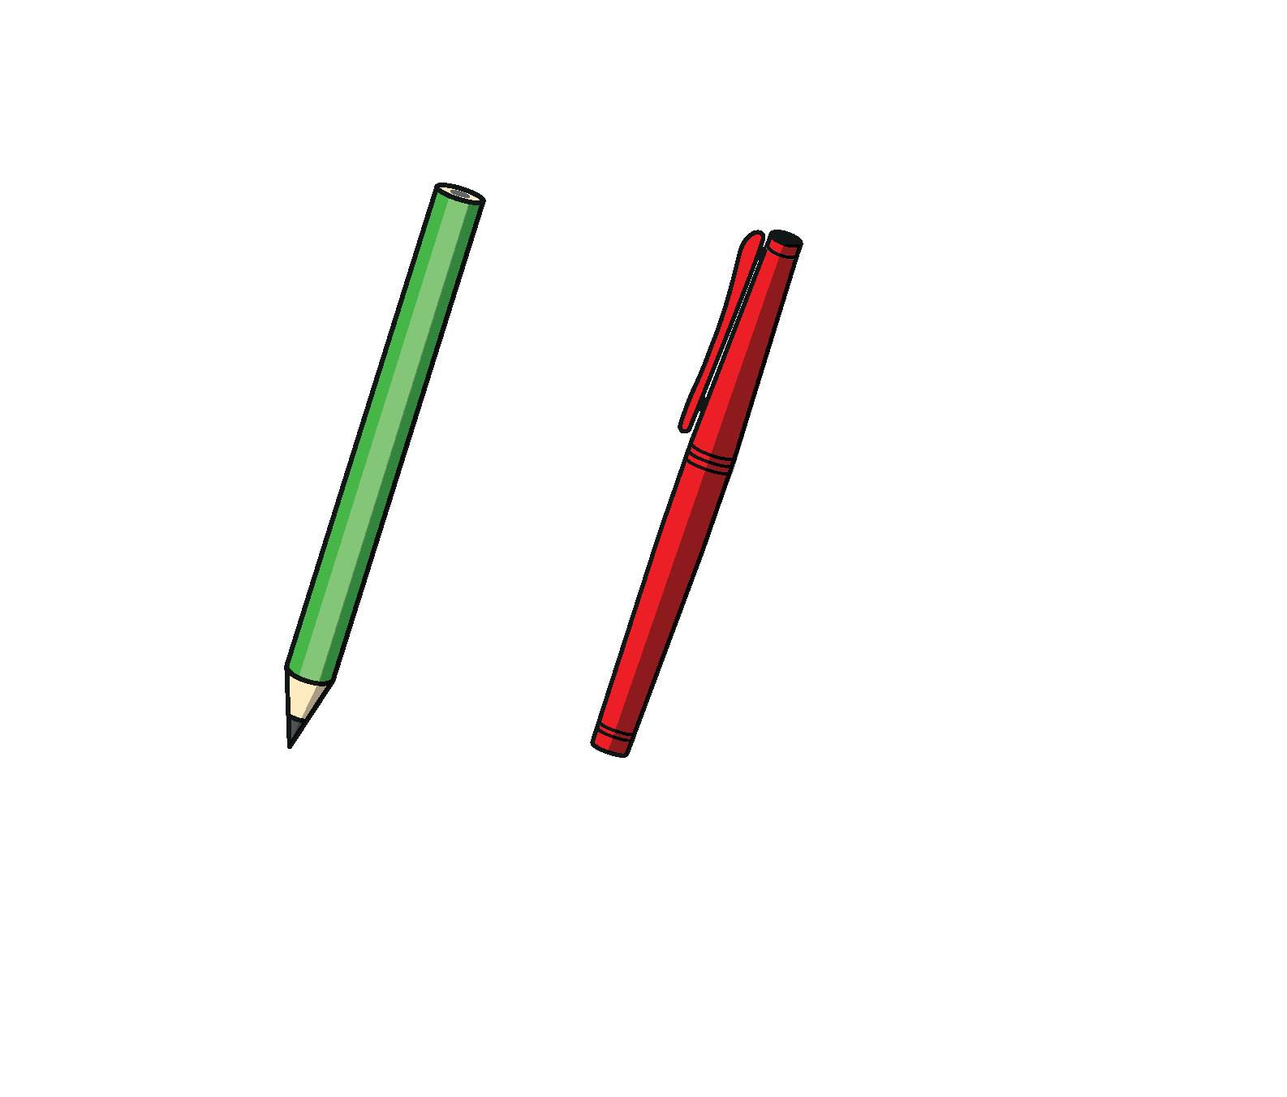

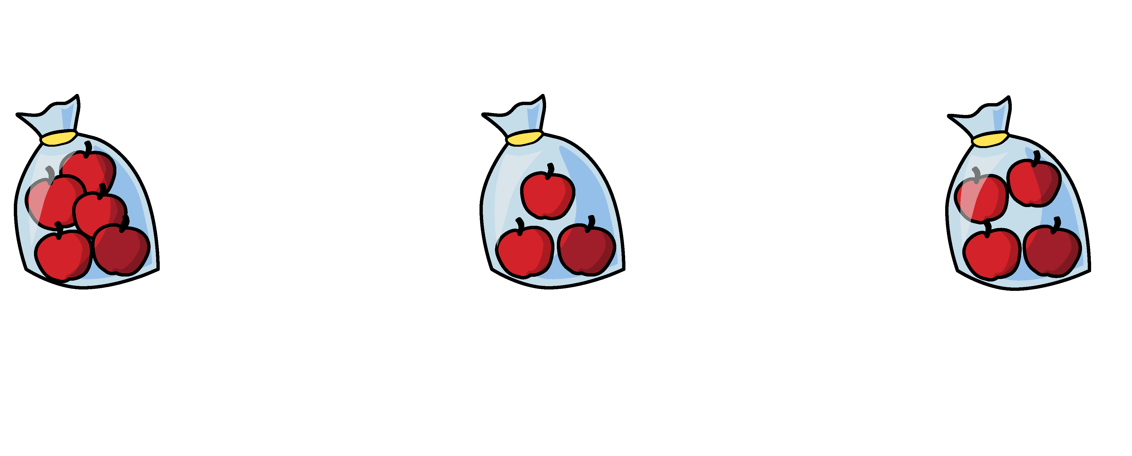


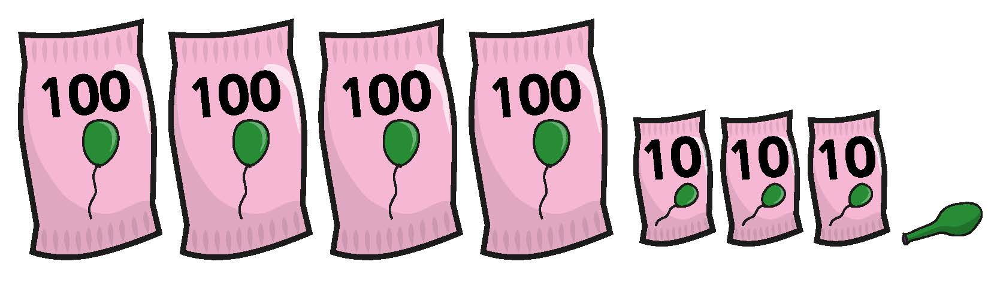

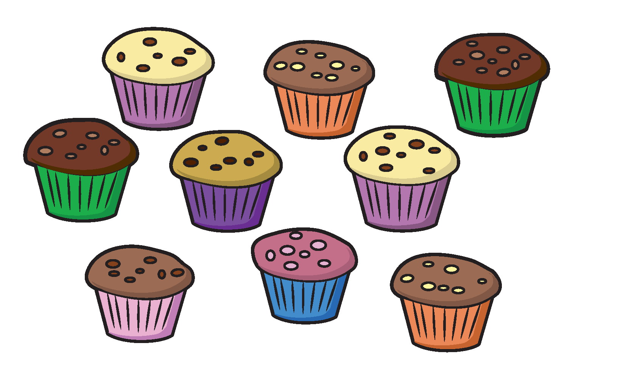
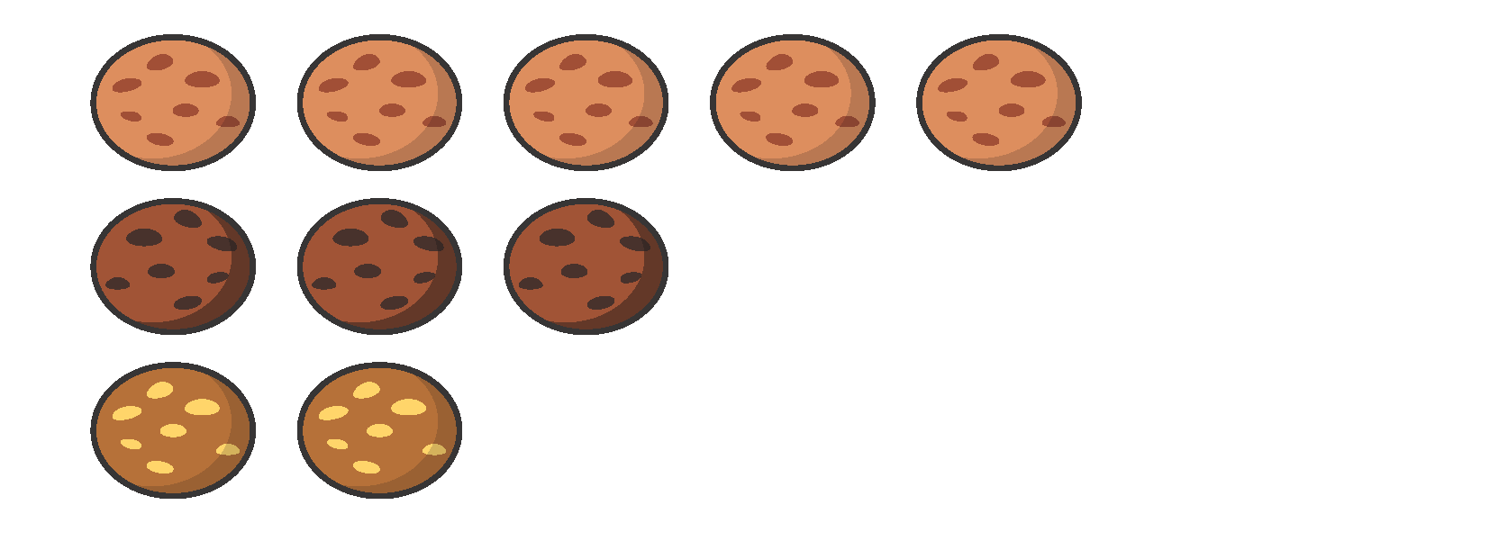
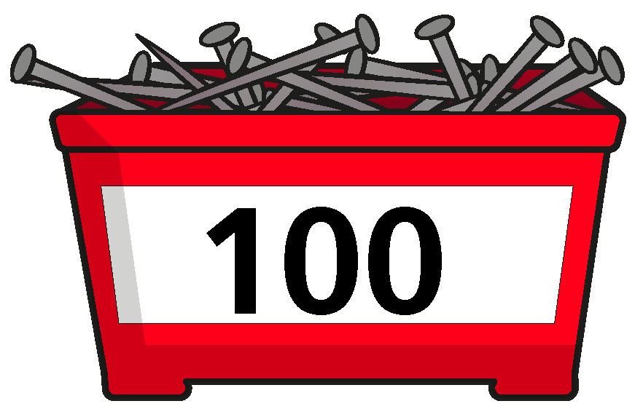
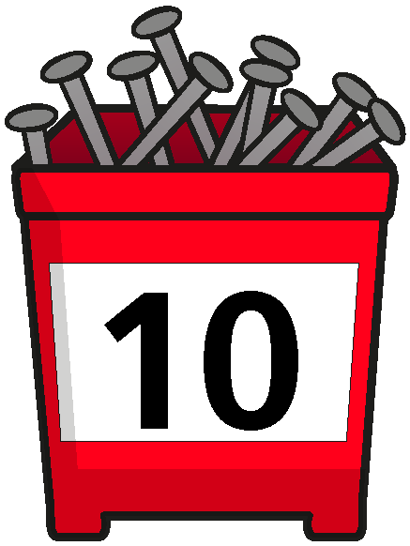

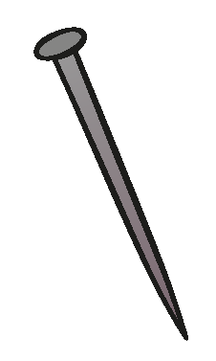
















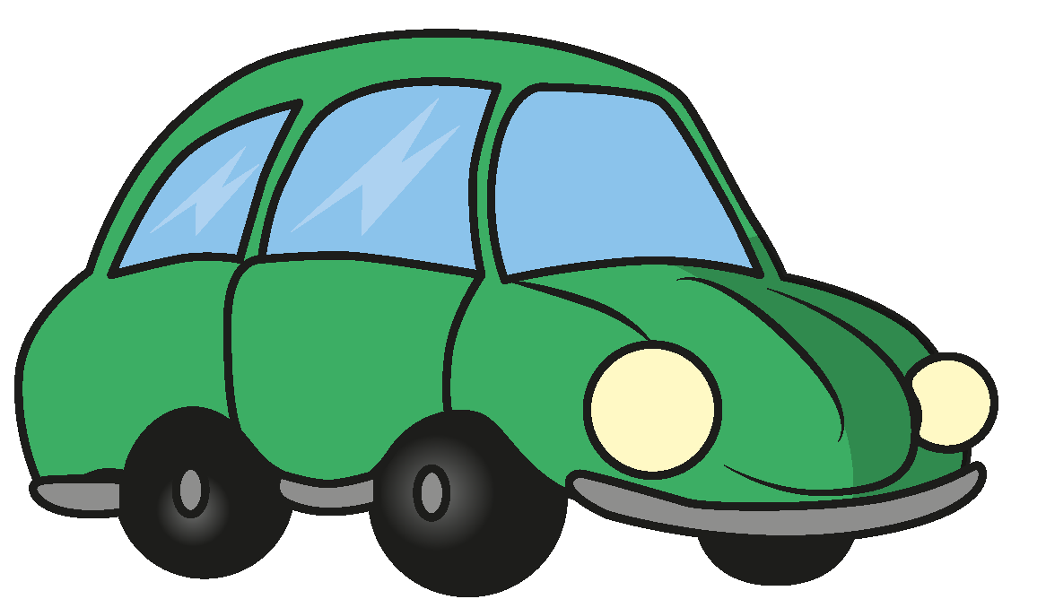
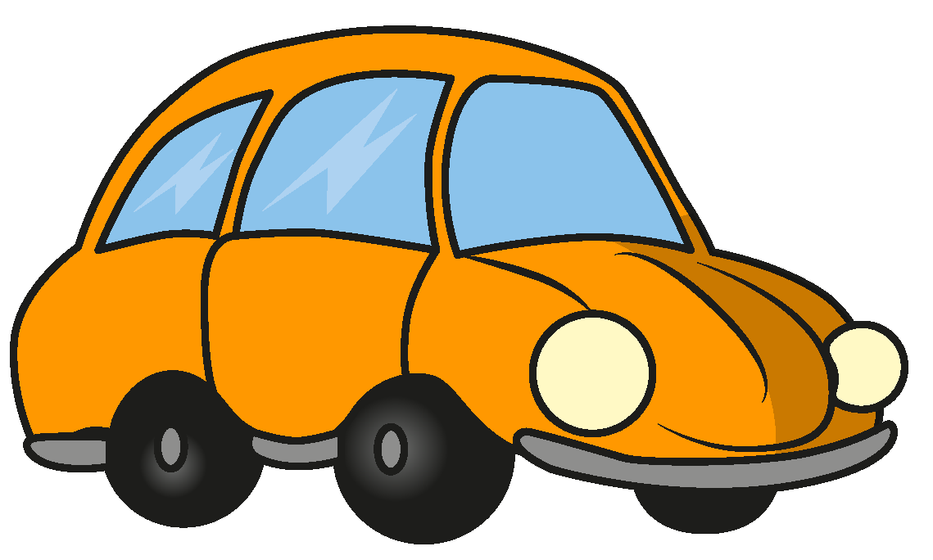




Slide 18


























































