Slide 1


Slide 3




1) What number is represented?
2) How many tens are there in 100?
How many tens are there in 200?
How many tens are there in 400?
How many tens are there in 420?
How many hundreds are there in 4,200?
Th | H | T | O

Slide 4
1) What number is represented?
2) How many tens are there in 100?
How many tens are there in 200?
How many tens are there in 400?
How many tens are there in 420?
How many hundreds are there in 4,200?
3,524
Th | H | T | O
10
20
40
42
42

Slide 6
Th | H | T | O
3,524
3
5
is equal to thousands, hundreds,
tens and ones.
2
4

Slide 7

HTh | TTh | Th | H | T | O
21,067
2
1
is equal to ten-thousands, thousand, hundreds, tens and ones.
0
6
7
20,000
1,000
60
7
21,067 $=$ $+$ $+$ $+$
Have a think

Slide 8
6
2
0
9
1
3
620,913
HTh | TTh | Th | H | T | O
600,000
What is the value of the first digit?
What is the value the digit 9?
900
0
What is the value of the third digit?
Have a think

Slide 9
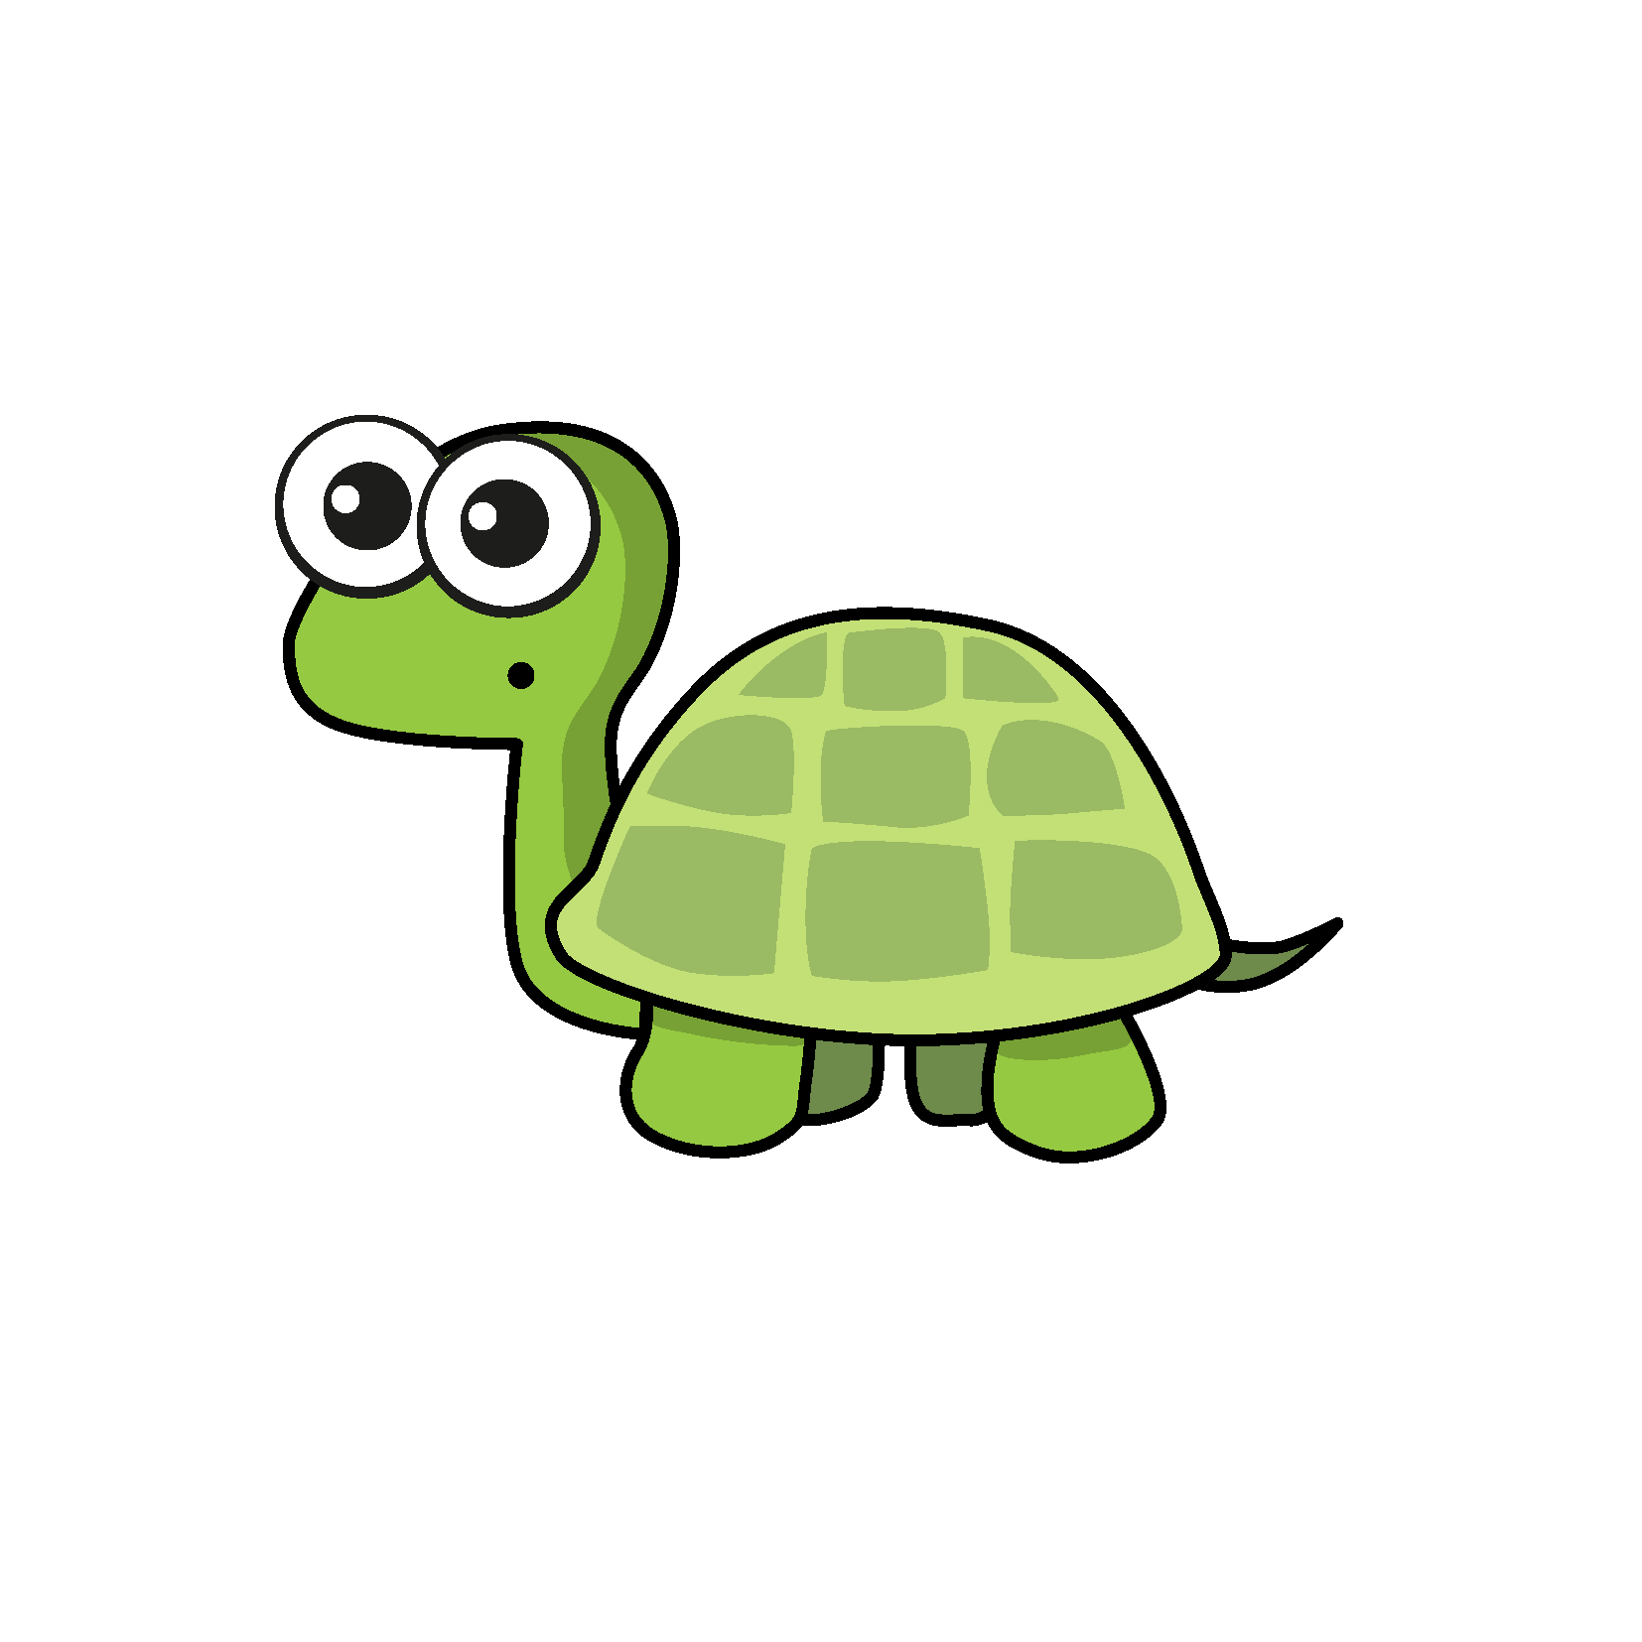
Complete the part-whole model.
204,539
2
4
5
3
9
200,000
4,000
500
30
9
Do you agree with Tiny?
No, Tiny has not considered the place value of each digit.
Have a think

Slide 10
Th | H | T | O
4,000
300
20
6
4,326 $=$ $+$ $+$ $+$
3,000
1,300
20
6
4,326 $=$ $+$ $+$ $+$

Slide 11
Th | H | T | O
4,000
300
20
6
4,326 $=$ $+$ $+$ $+$
3,000
1,300
20
6
4,326 $=$ $+$ $+$ $+$
4,000
200
120
6
4,326 $=$ $+$ $+$ $+$
3,000
1,300
10
16
4,326 $=$ $+$ $+$ $+$
Have a think

Slide 12

Complete the part-whole model.
640,530
500,000
140,000
500
30
100,000
$$+$$
40,000

Slide 13
Complete the part-whole model.
640,530
300,000
340,000
200
330
300,000
$$+$$
40,000
Have a think

Slide 14


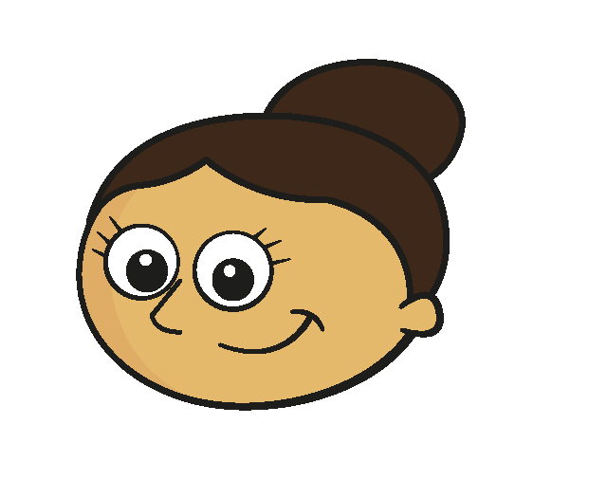
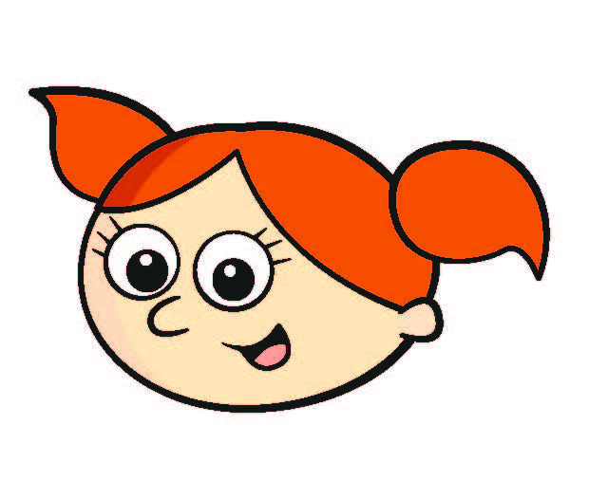
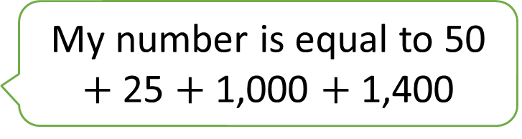
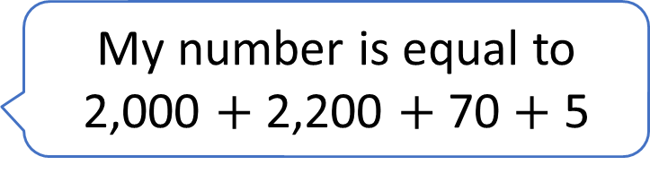
Which children are describing the same numbers?
My number is equal to 2,000 $+$ 2,200 $+$ 70 $+$ 5
Teddy
My number has 2 thousands, 4 hundreds, 7 tens and 5 ones.
Amir
My number is equal to 50 $+$ 25 $+$ 1,000 $+$ 1,400
Dora
My number is equal to 42 hundreds, 6 tens and 15 ones
Alex
Have a think

Slide 15
Which children are describing the same numbers?
My number is equal to 2,000 $+$ 2,200 $+$ 70 $+$ 5
4,
275
Teddy
My number has 2 thousands, 4 hundreds, 7 tens and 5 ones.
2,475
Amir
My number is equal to 50 $+$ 25 $+$ 1,000 $+$ 1,400
2,400
2,475
Dora
My number is equal to 42 hundreds, 6 tens and 15 ones
Alex
4,200
4,275
Teddy and Alex
Amir and Dora

Slide 16



Slide 17
Have a go at questions

Slide 18
I do
You do

Slide 19












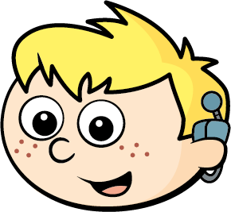



Rosie
Alex
Amir
Whitney
Ron
Dexter
Annie
Tommy
Mo
Jack
Eva
Teddy
Max
Kim
Jo
Sam

Slide 20

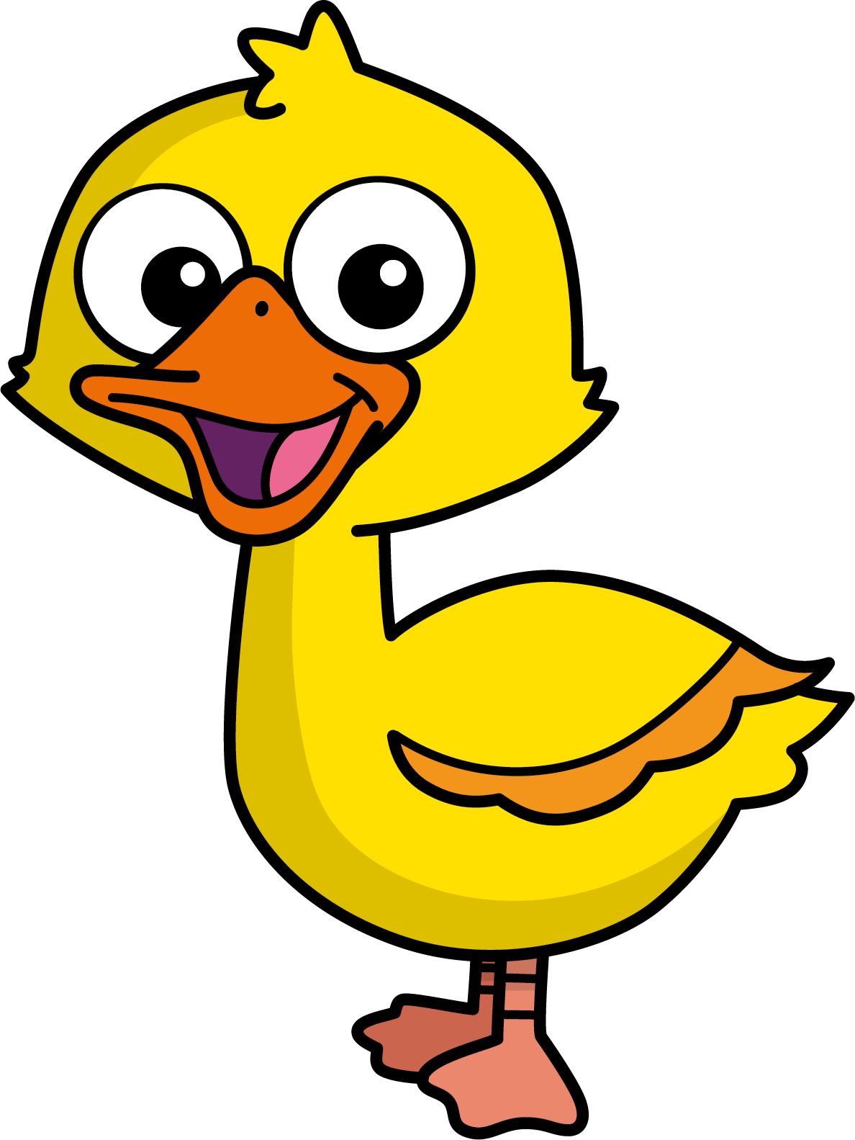
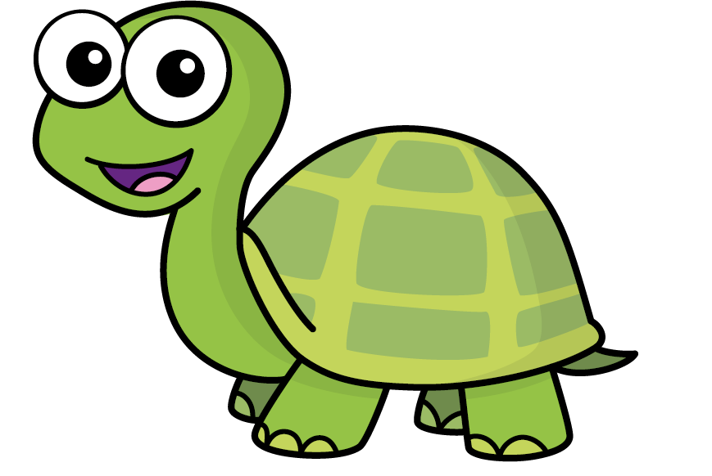
Speech bubble text – replace with any character head.
Speech bubble text – replace with any character head.
Bee
Diddy
Tiny

Slide 21







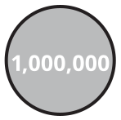
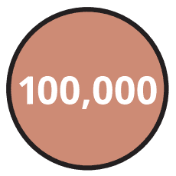
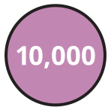
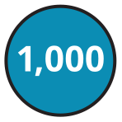
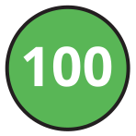
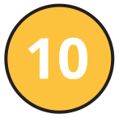
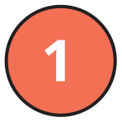
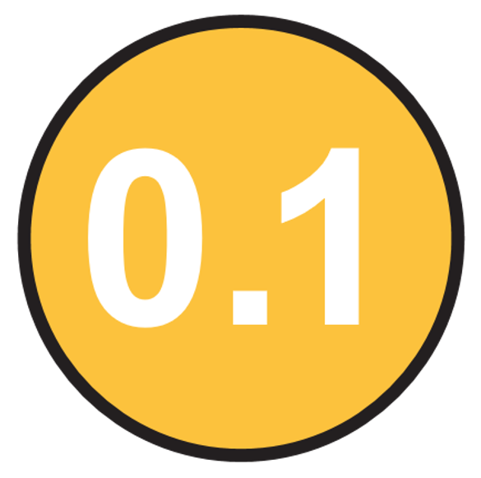
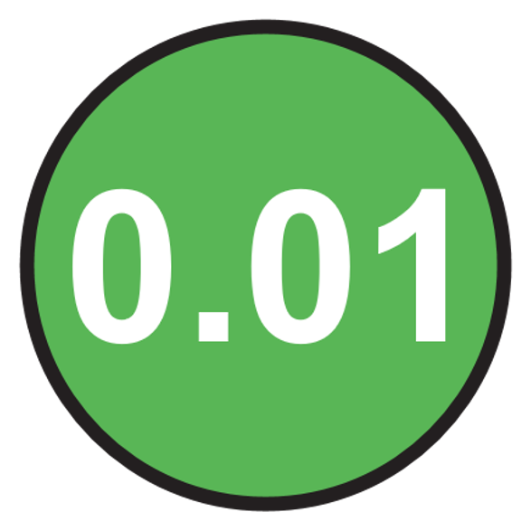
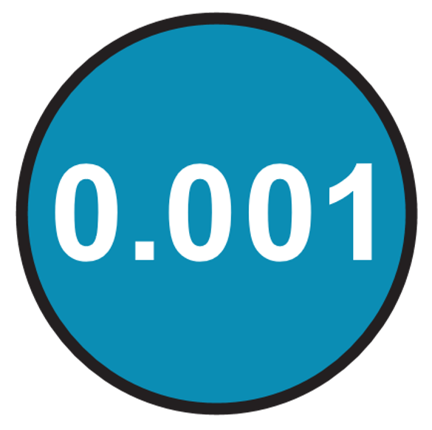
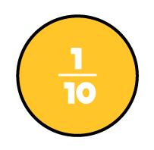

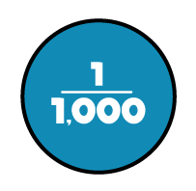


M | HTh | TTh | Th | H | T | O | Tth | Hth | Thth
100
40 | 60
Millions | Thousands |  |  | Ones
O | H | T | O | H | T | O

Slide 22





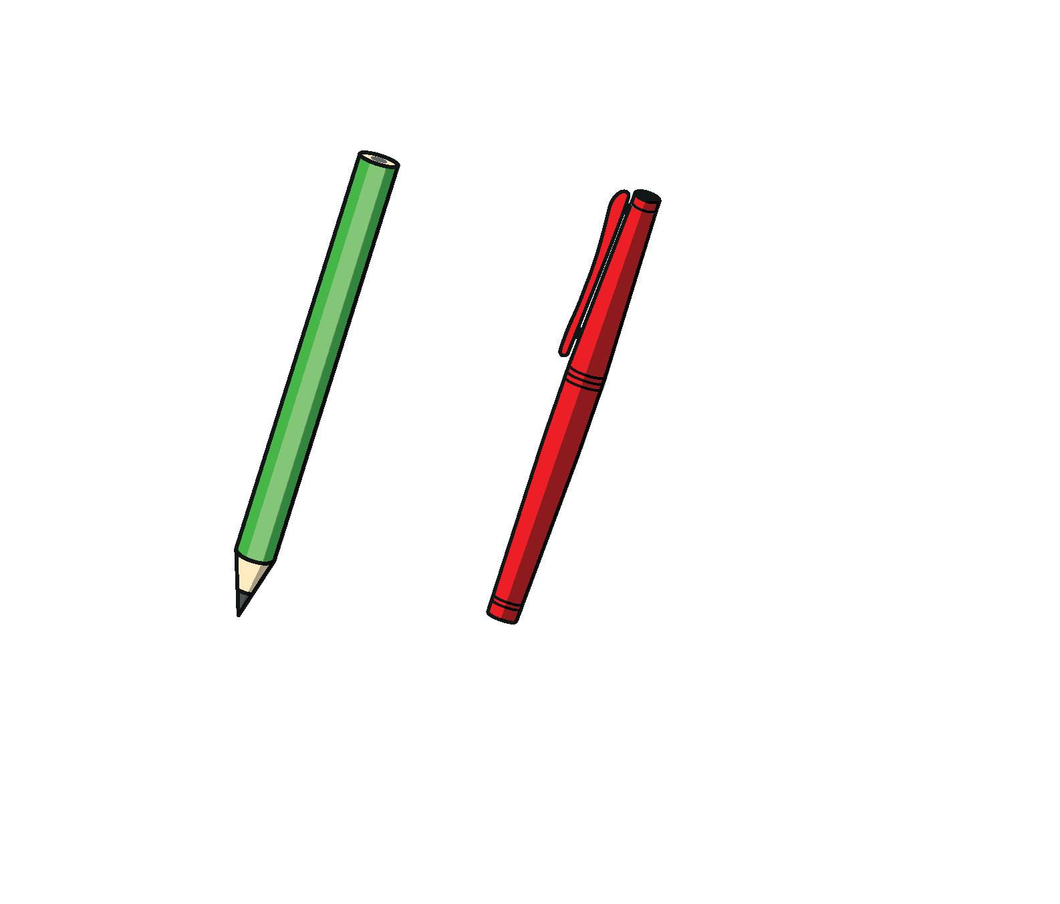

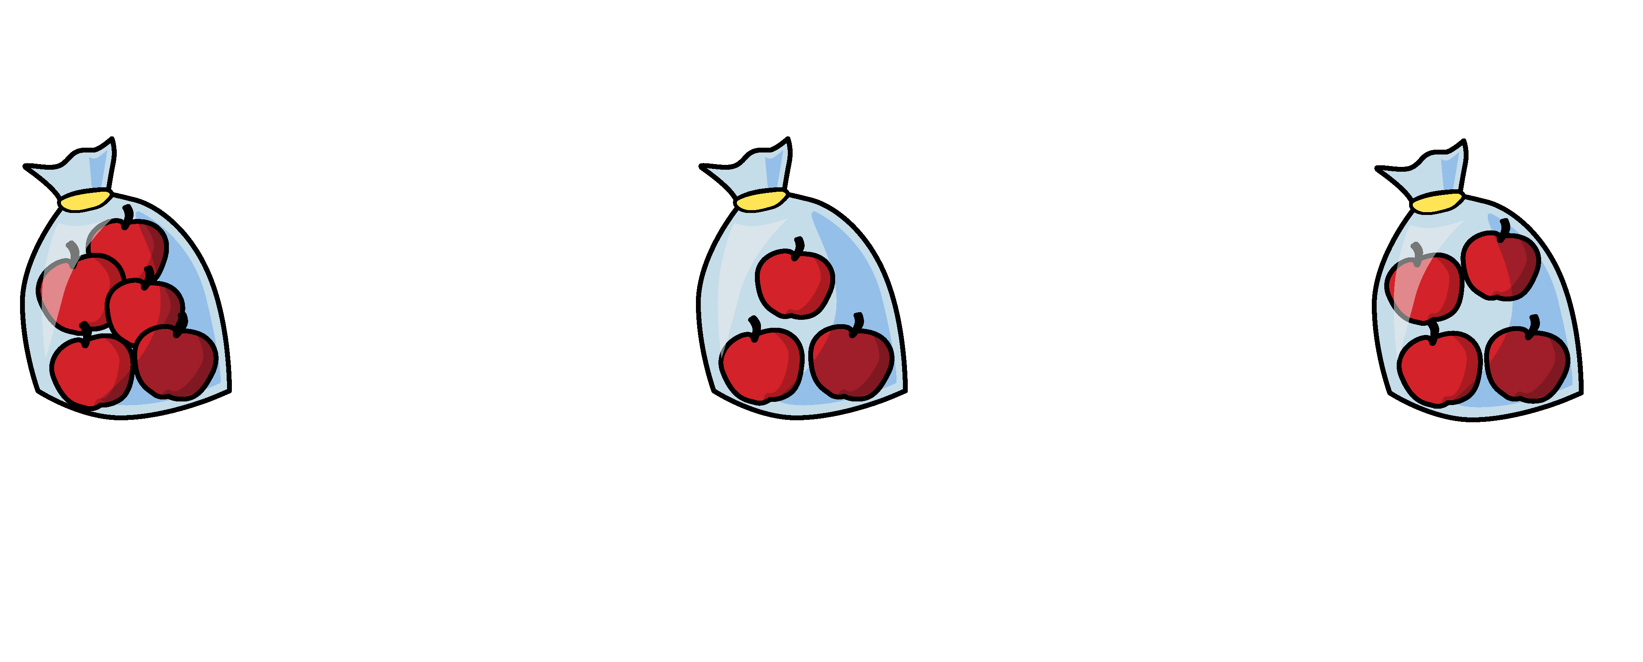


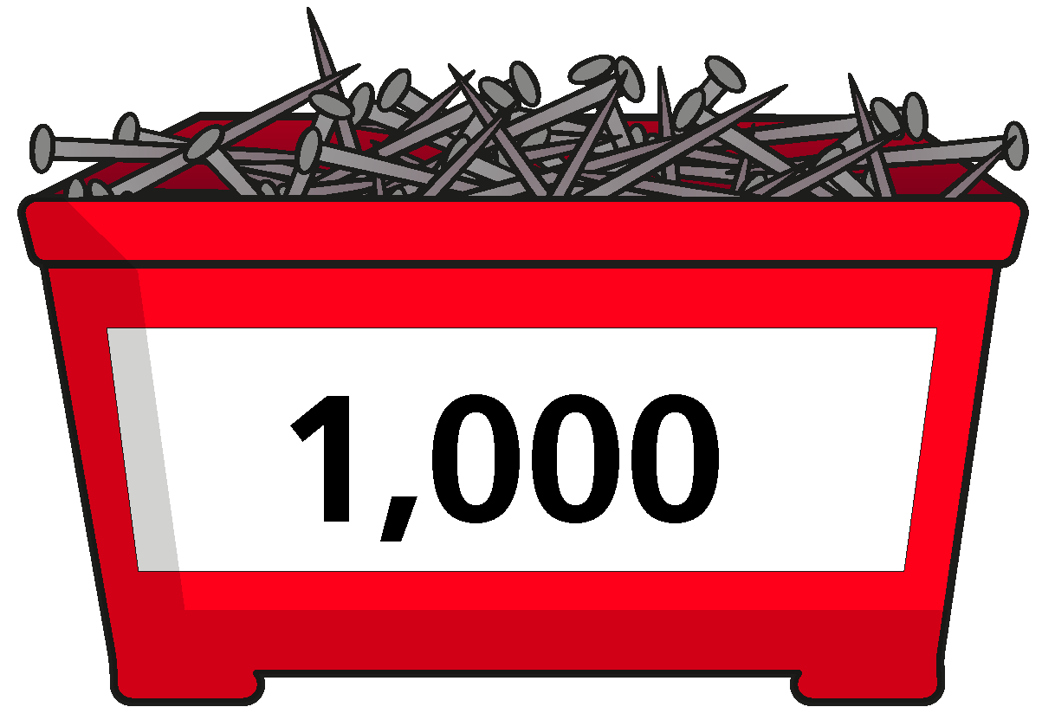
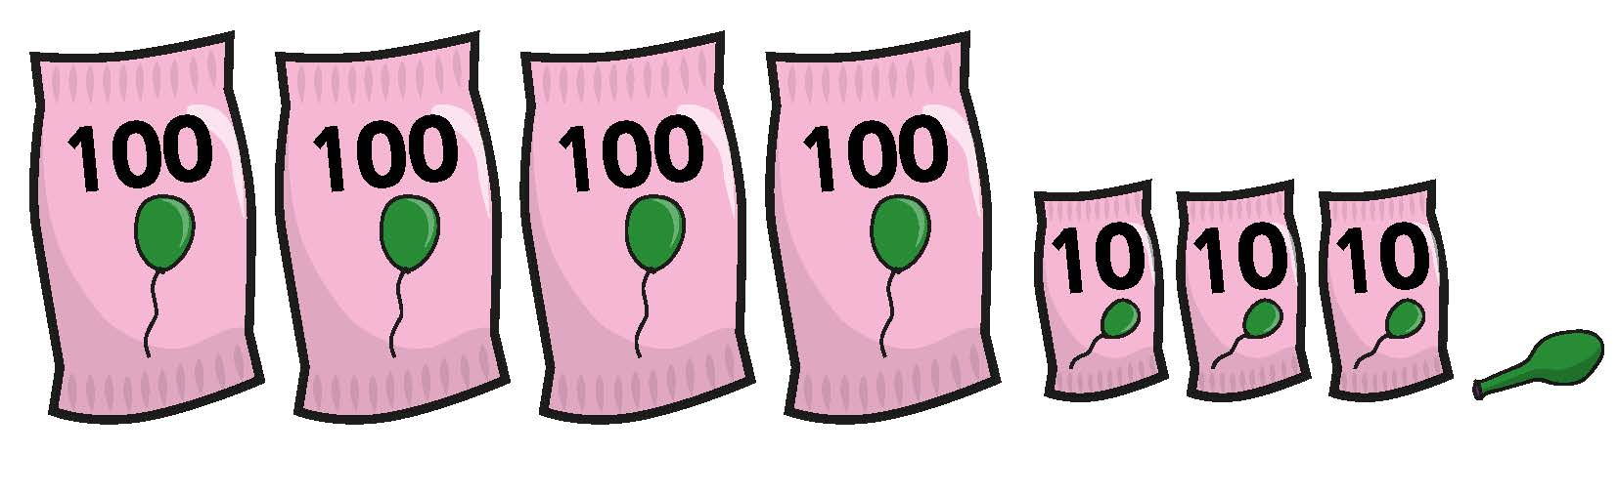

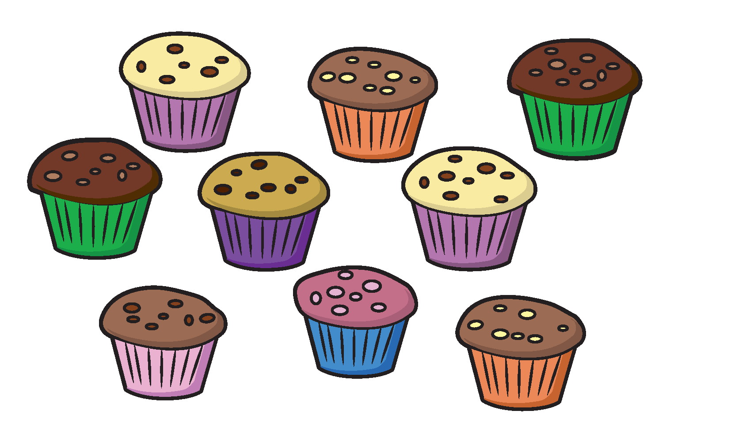
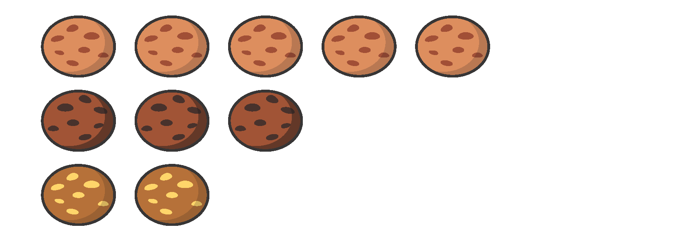

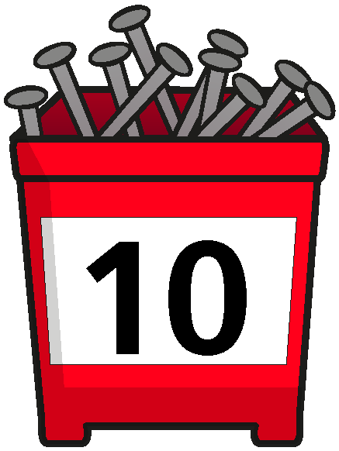

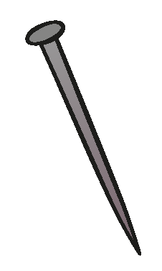
















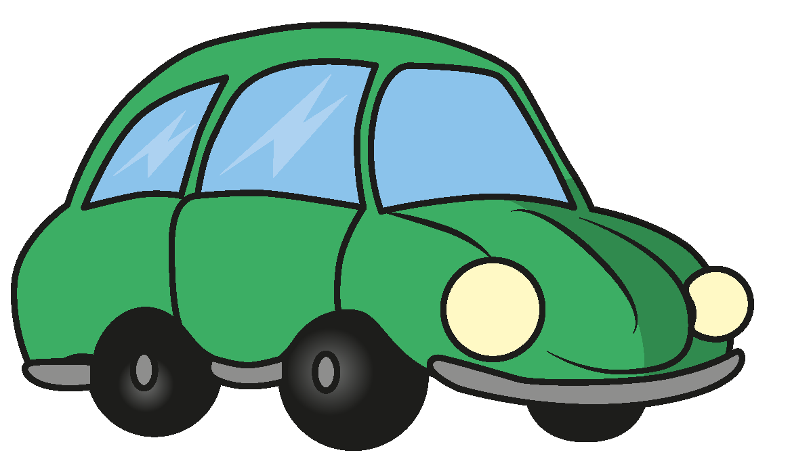
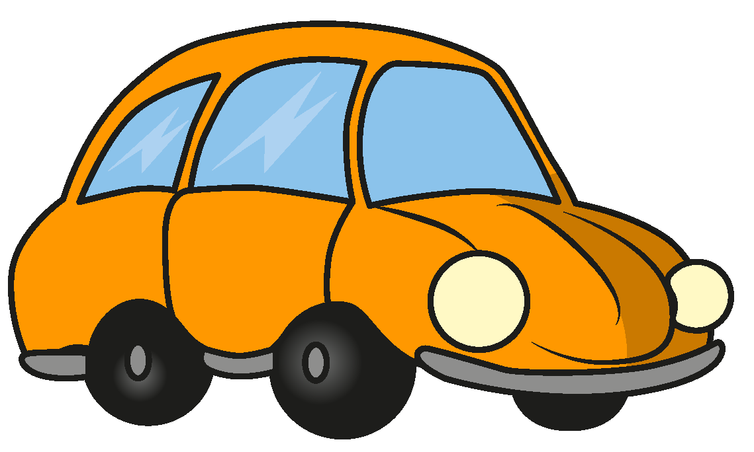




Slide 23


























































