Slide 1

Why is this so difficult to read?
in a hole in the ground there lived a hobbit not a nasty dirty wet hole filled with the ends of worms and an oozy smell nor yet a dry bare sandy hole with nothing in it to sit down on or to eat it was a hobbit-hole and that means comfort it had a perfectly round door like a porthole painted green with a shiny yellow brass knob in the exact middle the door opened on to a tube-shaped hall like a tunnel a very comfortable tunnel without smoke with panelled walls, and floors tiled and carpeted provided with polished chairs and lots and lots of pegs for hats and coats the hobbit was fond of visitors
What would make the meaning clearer?

Slide 2
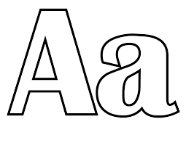

Capital letters
A sentence always begins with a capital letter.
When I is used on its own, it is always a capital letter, e.g. They waited until I reached them before boarding the train to Edinburgh.

Slide 3

Capital letters always come at the start of …
  names of people and their titles, e.g. George Harris, Mr George Harris, Uncle George, Dr Harris
  places, e.g. High Street, Guildford, Surrey, England, Europe
  their adjectives (describing words), e.g. English, Welsh, European
  days of the week, special days, e.g. Christmas Eve and months, but not seasons

Slide 4
Capital letters always come at the start of …
  titles of books, films, television programmes, plays, bands etc, e.g. The Hobbit, Kensuke’s Kingdom, Frozen, Friends, Stranger Things, Macbeth, Take That, One Direction
  brand names of products we buy and places we shop, e.g. Coca Cola, Hovis, Mini, Next, Nike, Rimmel, Samsung, Tesco.

Slide 5

Full stops
A sentence always ends with a full stop, unless it ends with a question mark (?) or exclamation mark (!).

Slide 6
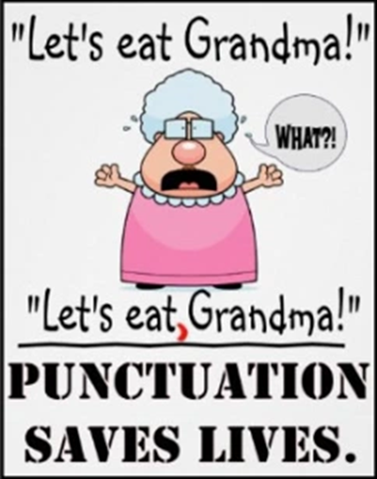
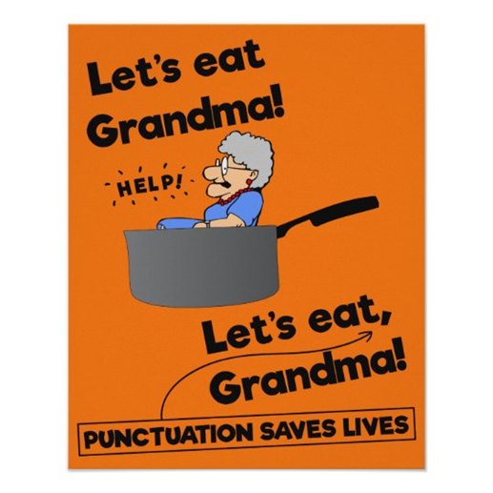
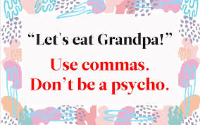
The power of the comma!

Slide 7
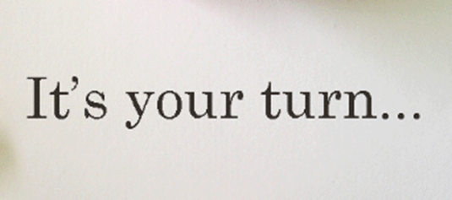
Insert commas into the sentences on your worksheet where you think appropriate.
Slow children crossing.
Look at that huge hot dog!
Go get him doctors!
After we left Grandma Dad and I went to the cinema.
James walked on his head a little higher than usual.
The student said the teacher is crazy.

Slide 8
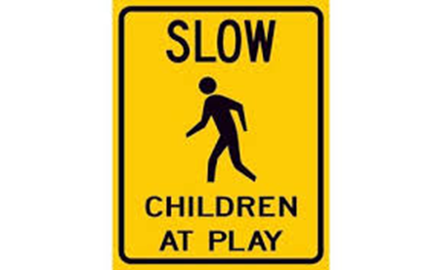
Let’s see how where you place commas (or their absence) can change a sentence’s meaning…
Slow children crossing.
Slow, children crossing.

Slide 9
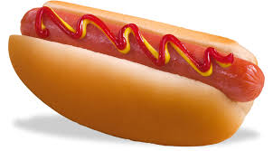


Let’s see how where you place commas (or their absence) can change a sentence’s meaning…
Look at that huge hot dog!
Look at that huge, hot dog!

Slide 10
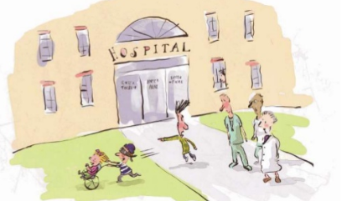
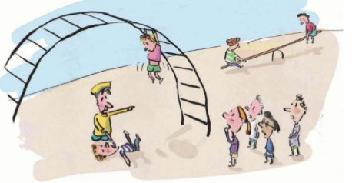
Let’s see how where you place commas (or their absence) can change a sentence’s meaning…
Go get him, doctors! Go, get him doctors!

Slide 11
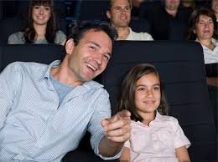

Let’s see how where you place commas (or their absence) can change a sentence’s meaning…
After we left Grandma, Dad and I went to the cinema.
After we left, Grandma, Dad and I went to the cinema.

Slide 12


Let’s see how where you place commas (or their absence) can change a sentence’s meaning…
James walked on, his head a little higher than usual.
James walked on his head, a little higher than usual.

Slide 13
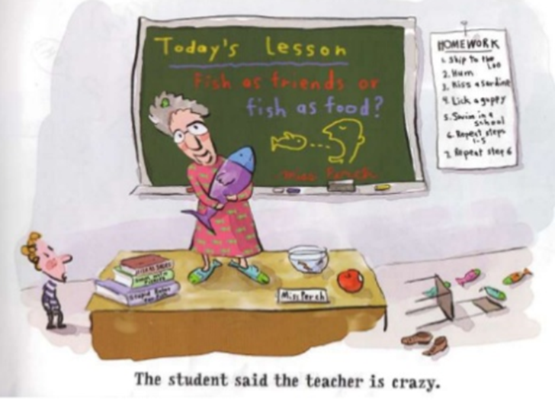
Let’s see how where you place commas (or their absence) can change a sentence’s meaning…
The student said the teacher is crazy.

Slide 14
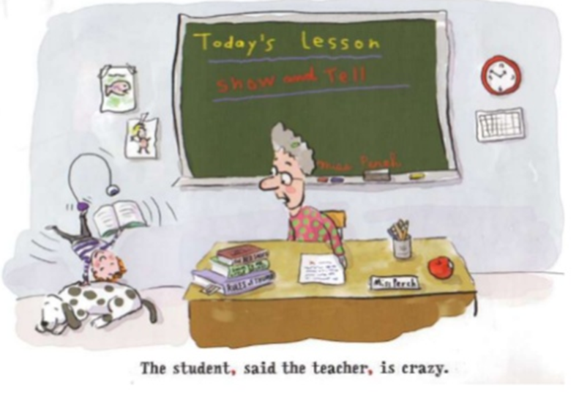
Let’s see how where you place commas (or their absence) can change a sentence’s meaning…
The student, said the teacher, is crazy.

